Slide 1
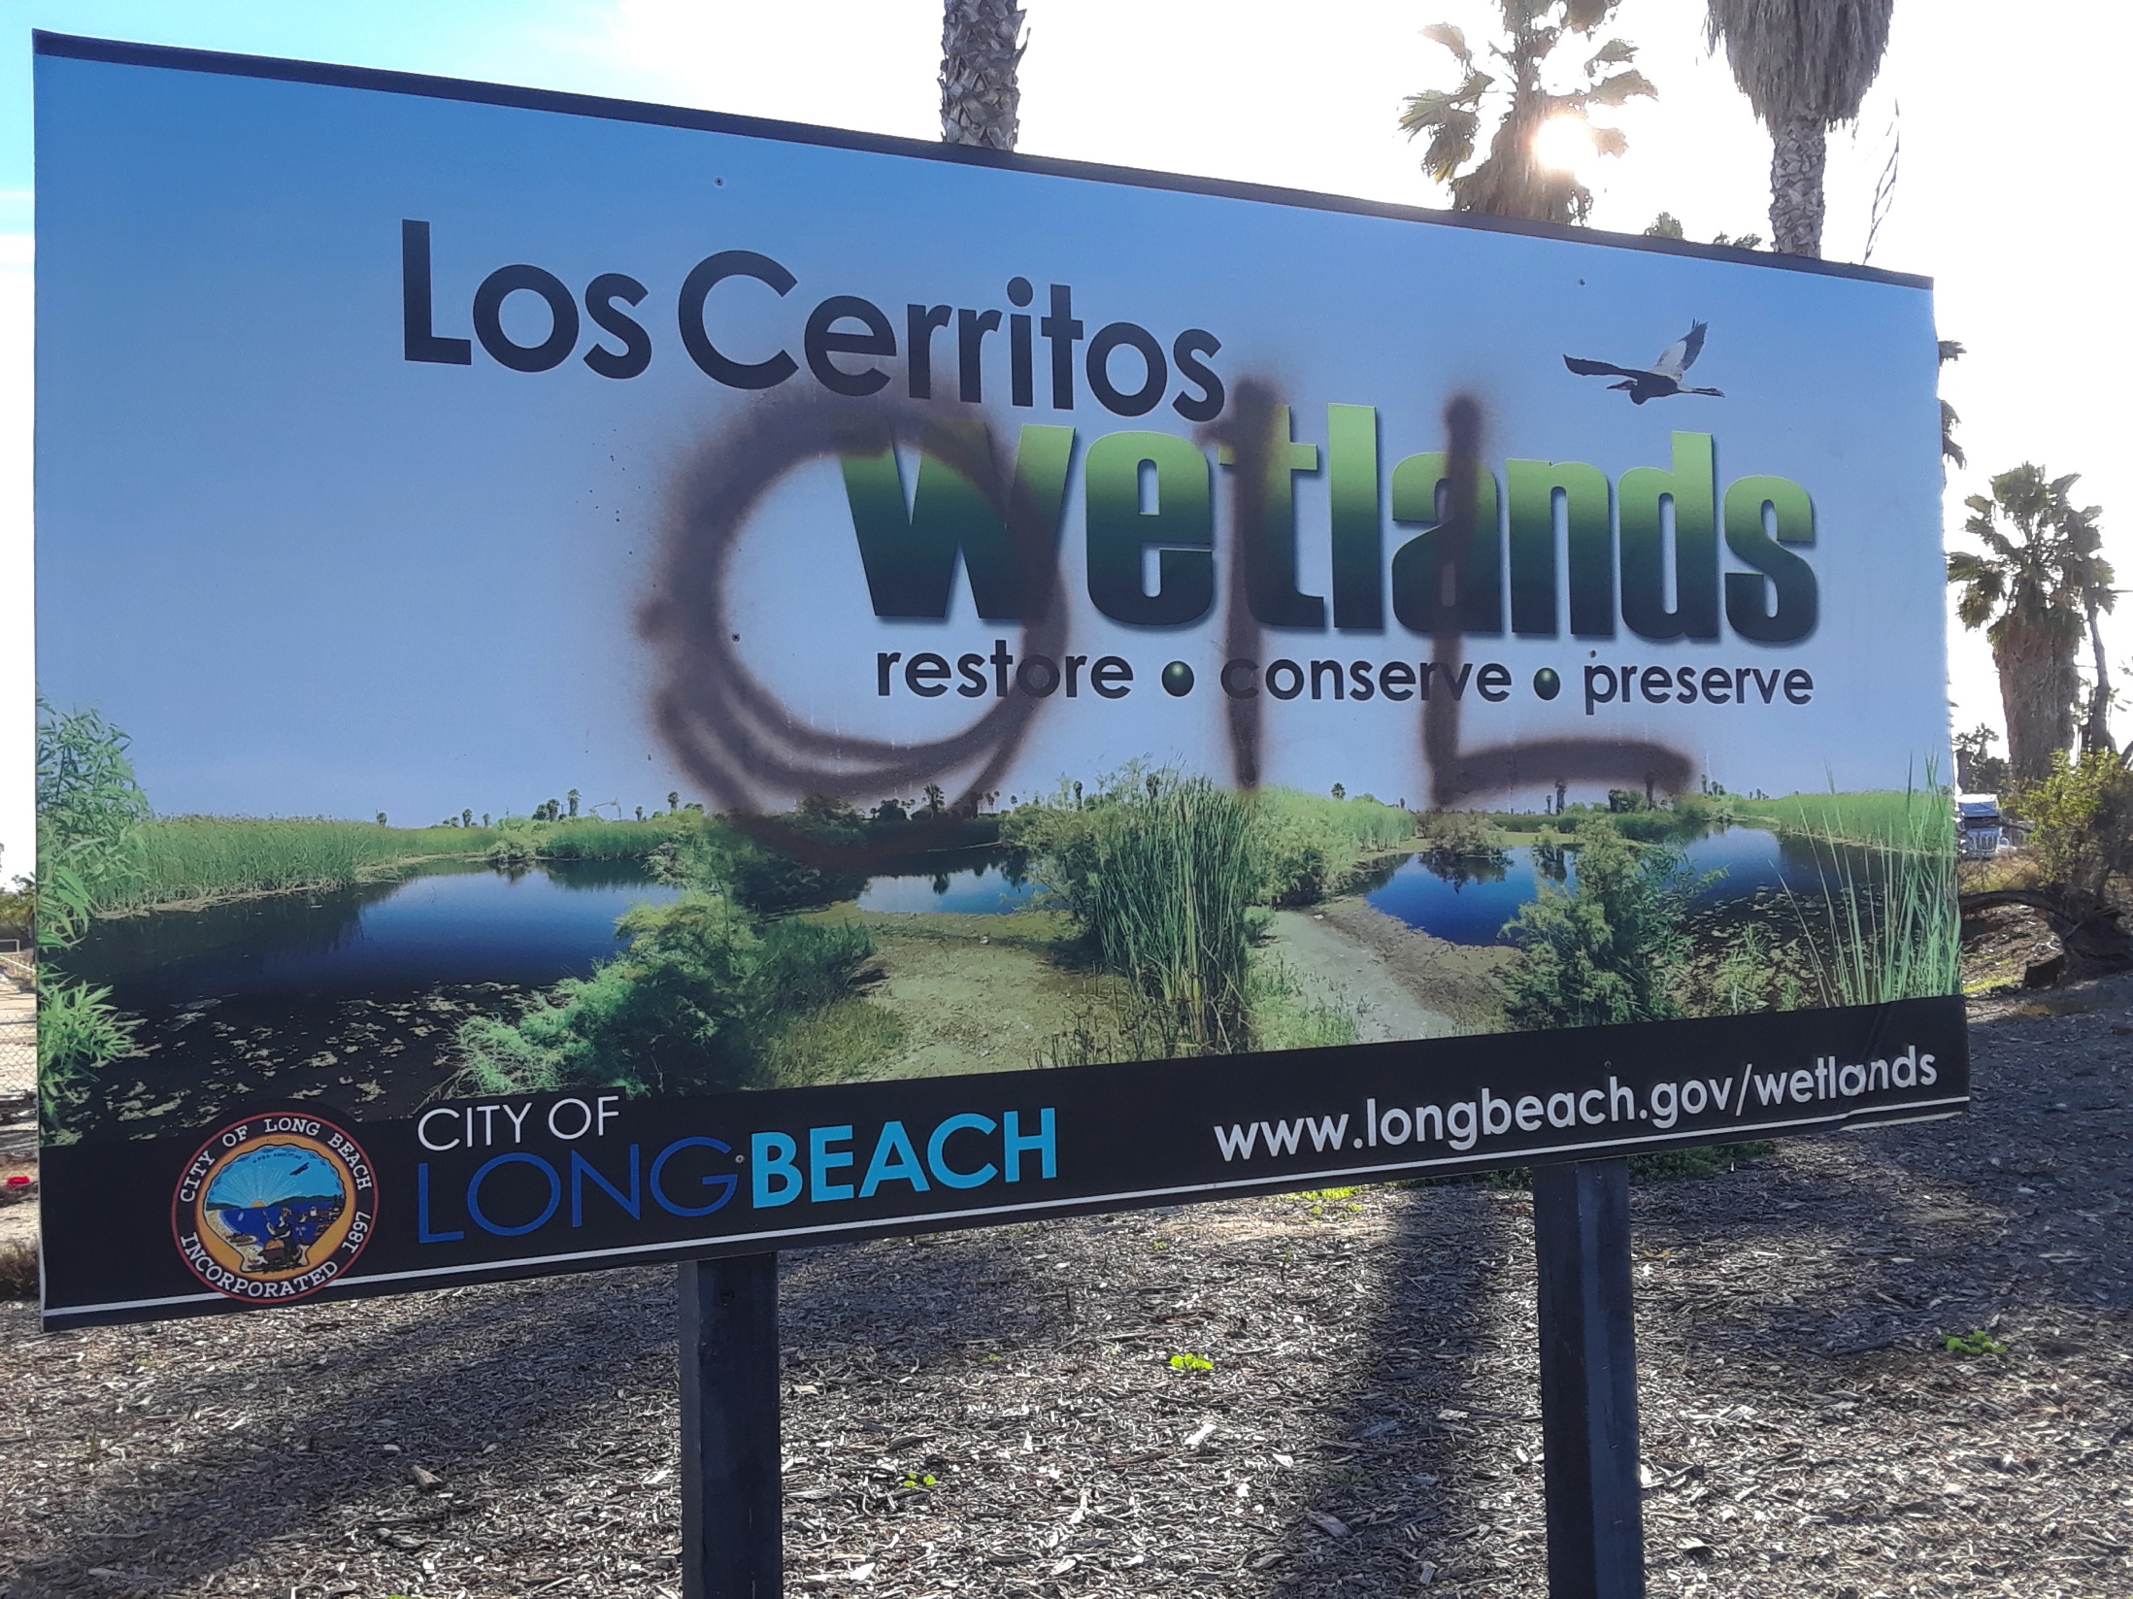
The Upper Los Cerritos Wetlands Mitigation Bank - banking on protecting and expanding oil drilling – NOT wetlands restoration.

Slide 2
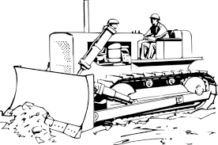
The Upper Los Cerritos Wetlands Mitigation Bank will fund “habitat creation,” not restoration. Existing wetlands and wildlife habitat will be destroyed as flood control infrastructure and habitat creation are prioritized over the preservation of a fragile and complex ecosystem.

Slide 3
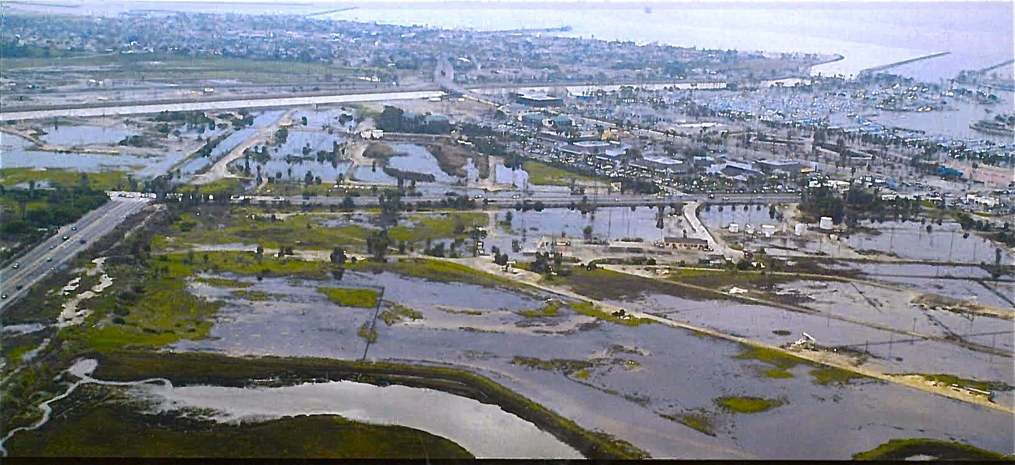
Mitigation credits will be sold to erase existing brackish wetlands and uplands habitats fed by seasonal rains and replace them with a salt marsh

Slide 4
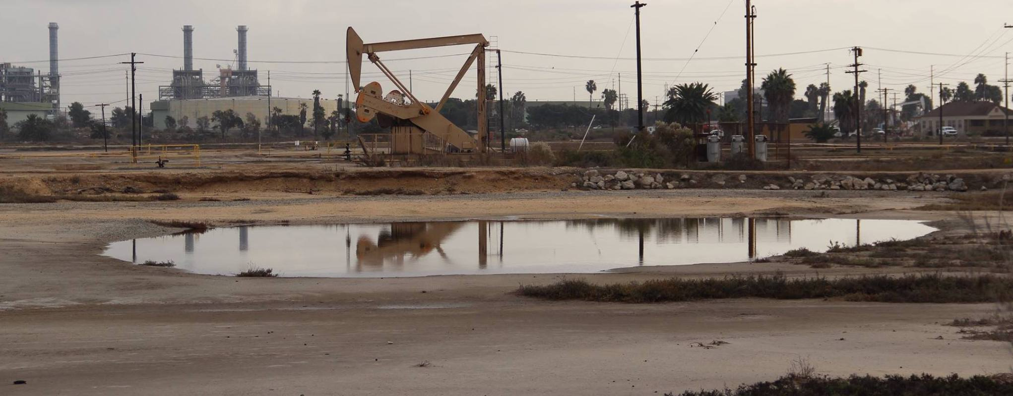
The mitigation bank will bulldoze, flood, and bury tribal cultural resources, including rare salt flats, in a Traditional Tribal Landscape within the sacred site of Puvungna.

Slide 5
The Upper Los Cerritos Wetlands Mitigation Bank will fund “habitat creation,” not restoration. Existing wetlands and wildlife habitat will be destroyed as flood control infrastructure and habitat creation are prioritized over the preservation of a fragile and complex ecosystem.

Slide 6
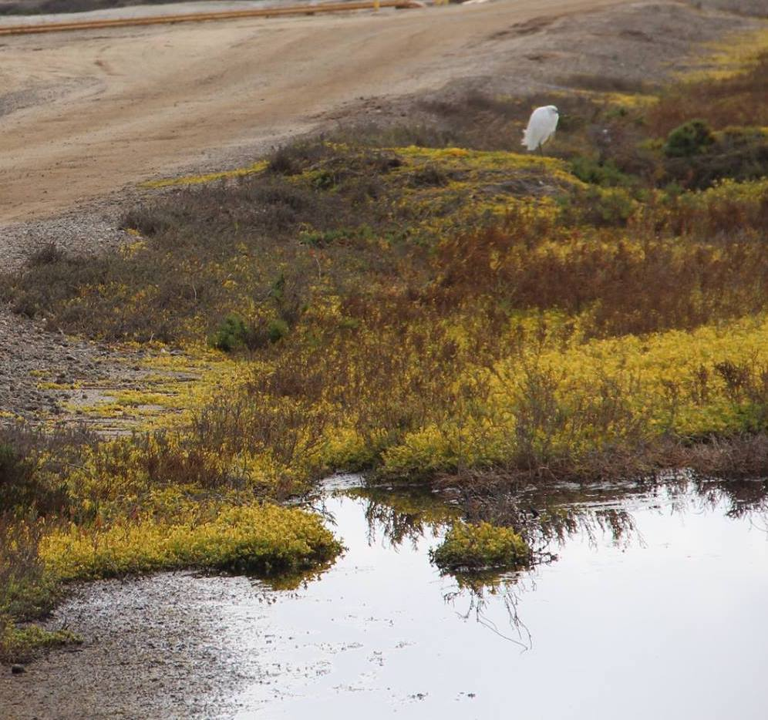
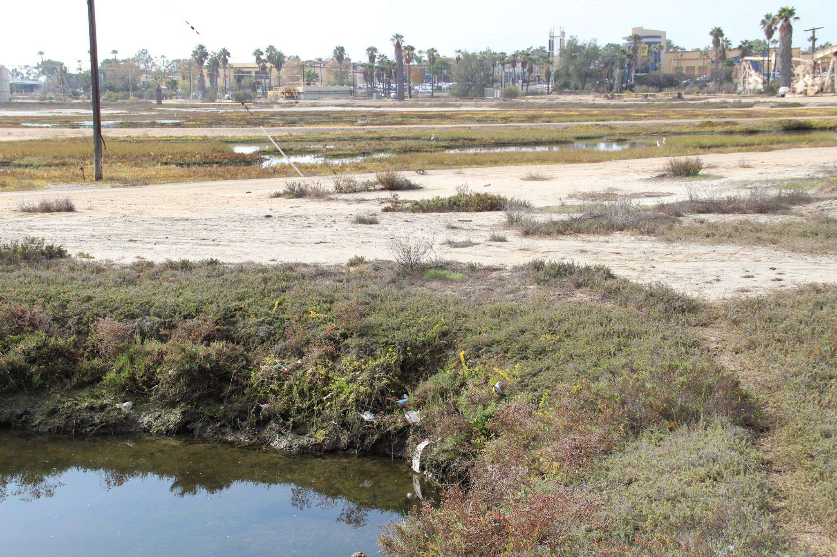
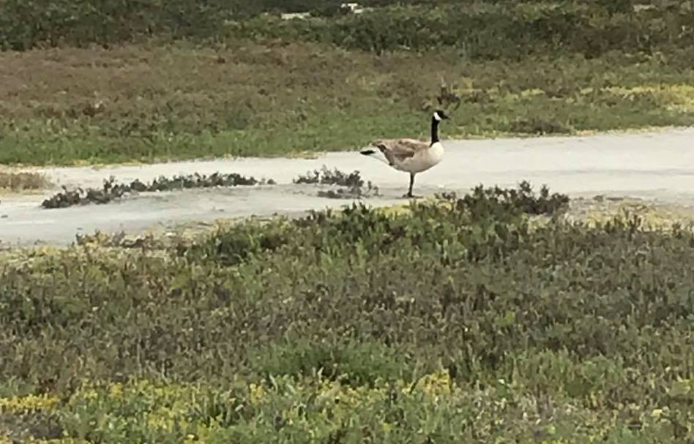
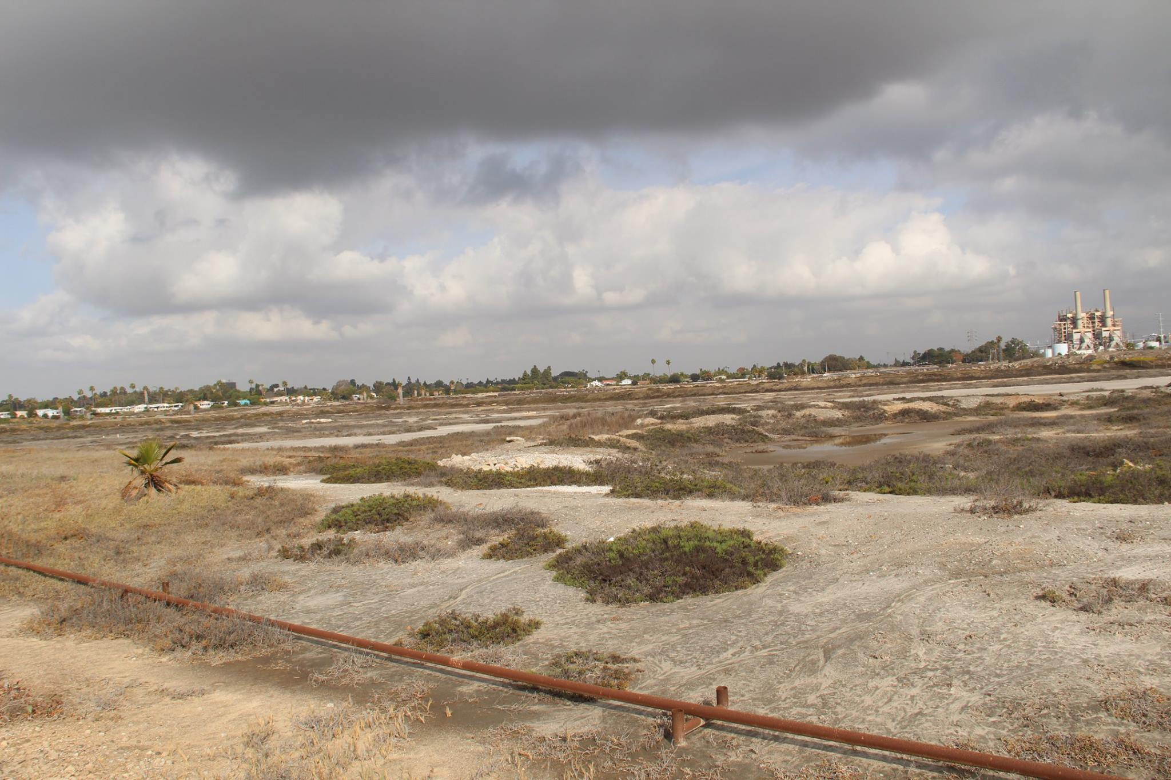
Existing wetlands habitat will be bulldozed, drowned, and buried as new salt marshes and flood control infrastructure are prioritized over the protection and preservation of wildlife habitat and a Tribal Traditional Landscape and Sacred Site.

Slide 7
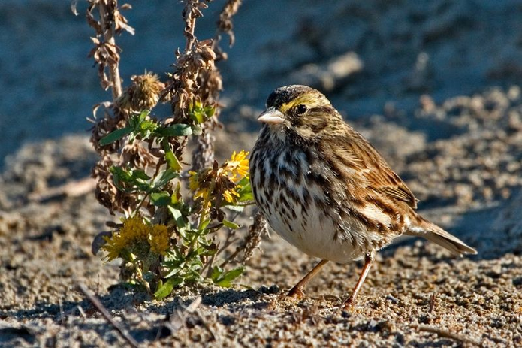
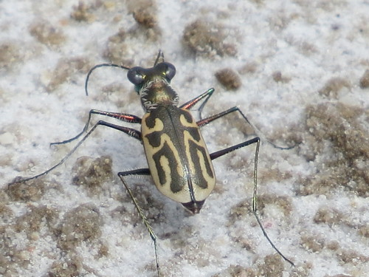
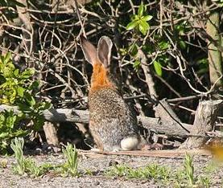
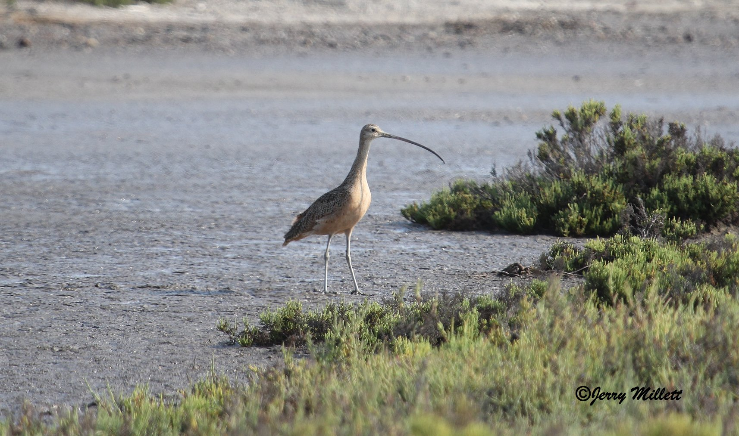
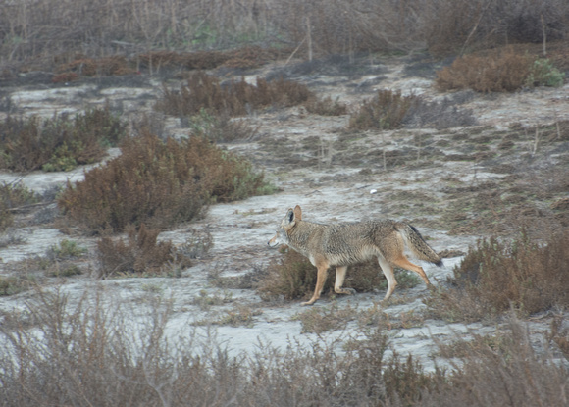
Flooding seasonal brackish wetlands and uplands to create a salt marsh monoculture is not restoration, but replacement. The Los Cerritos Wetlands are part of the estuary of the San Gabriel River and were never a full tidal salt marsh. All 10 acres of rare salt flats and most of the uplands will be lost, many residents will not survive the transition.

Slide 8
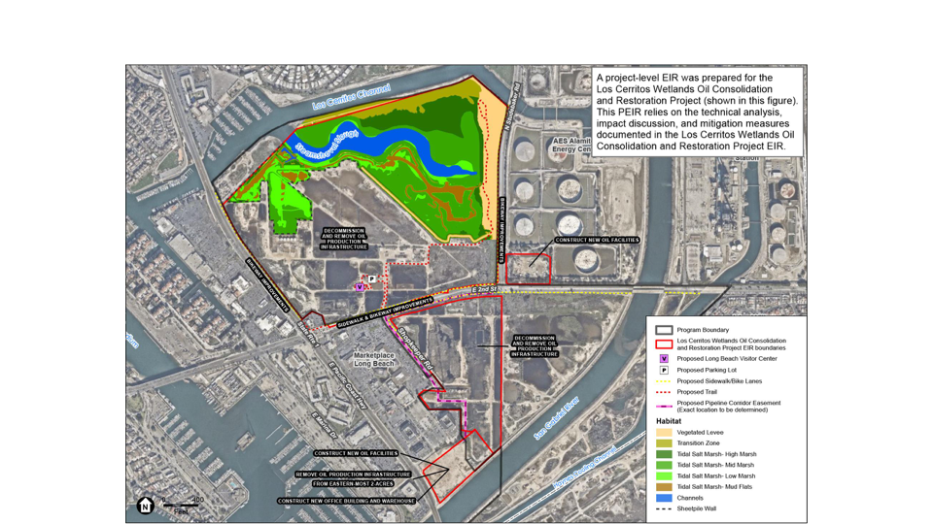

Steamshovel Slough will be extended over seasonal freshwater wetlands, The construction of a new berm across the wetlands will protect existing oil and gas operations, which will continue to operate for 20 years after Beach Oil Minerals new expanded oil operations are up and running.
--------
----

Slide 9
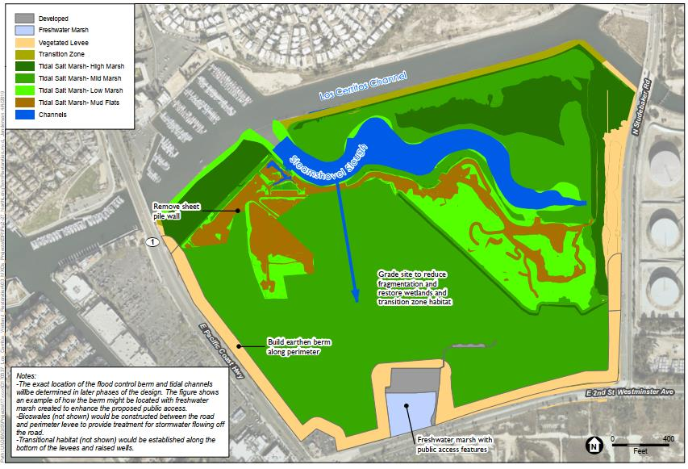
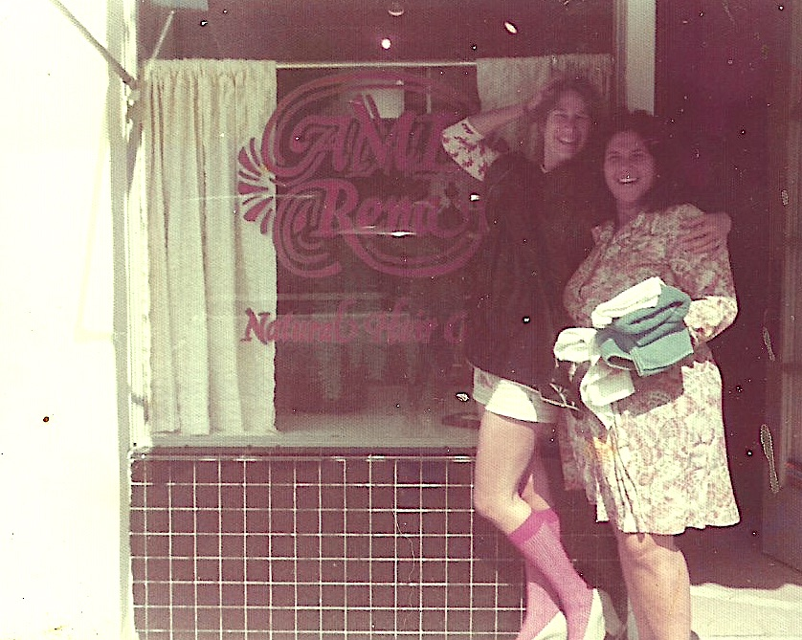

Eventually, high berms will be built on this area of the wetlands along PCH, 2nd St, and Studebaker Rd. to secure the In-N-Out, malls, industrial sites and proposed 5 to 7 story mixed-use complexes on PCH between the San Gabriel River and Loynes Dr.
NORTH AREA
------------------
----------
------------

Slide 10
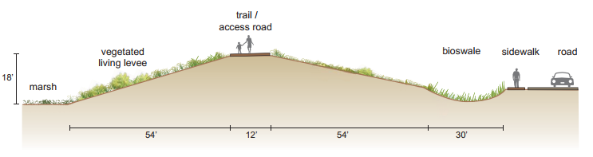
Berms will be 18 feet high.
Berms could will be paved for vehicles.
Berms will be set back to allow room for runoff from streets.
ALL WILL BE BUILT ON, AND ELIMINATE, EXISTING WETLANDS!!!

Slide 11
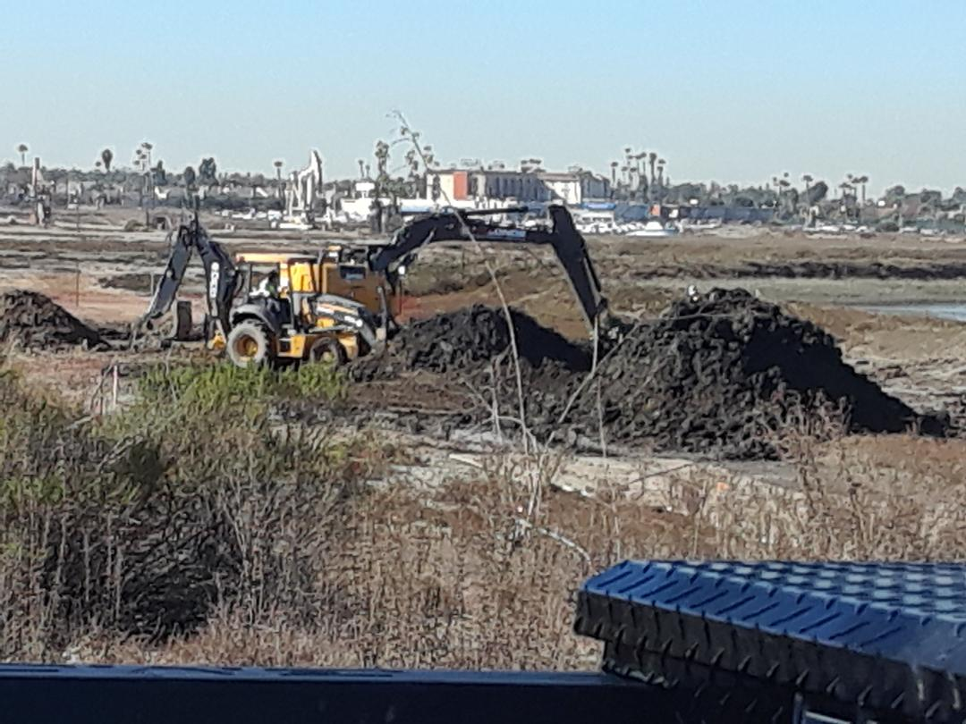
These wetlands will become storage sites for excavated and dredged soils until these are either used in flood control or hauled away. Existing wildlife areas will become construction zones for the next half century or even longer.

Slide 12
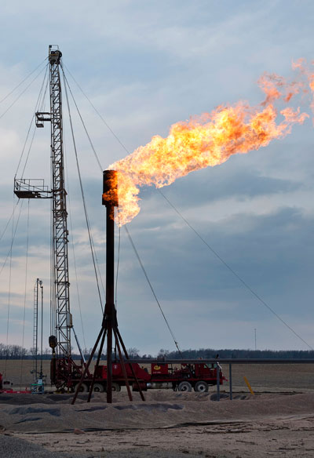
Neither Beach Oil Minerals nor LCW LLC can be trusted as both continue to poison the community and the ecosysem.

